Slide 1
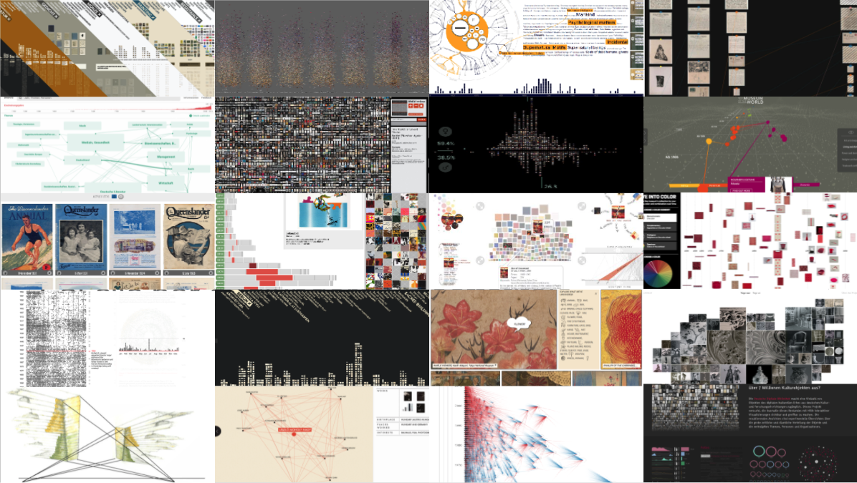
Some thoughts on information visualization:
Visualization as an epistemic tool
Dr. Linda Freyberg (UCLAB, FH Potsdam)
Workshop on Information Visualization in the (Digital) Humanities
27th-28th of October 2022, University of Graz

Slide 2
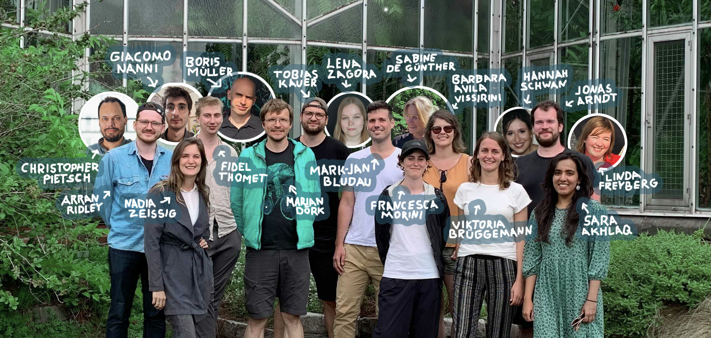
UCLAB

Slide 3
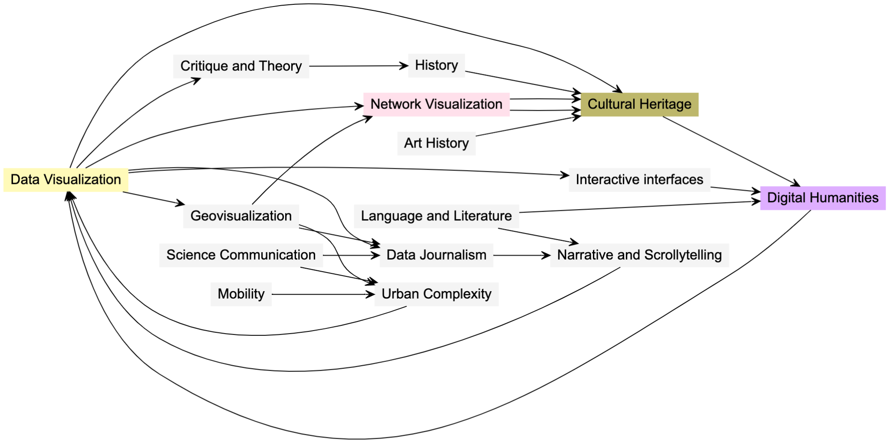
UCLAB ➝ Areas of research
https://uclab.fh-potsdam.de

Slide 4
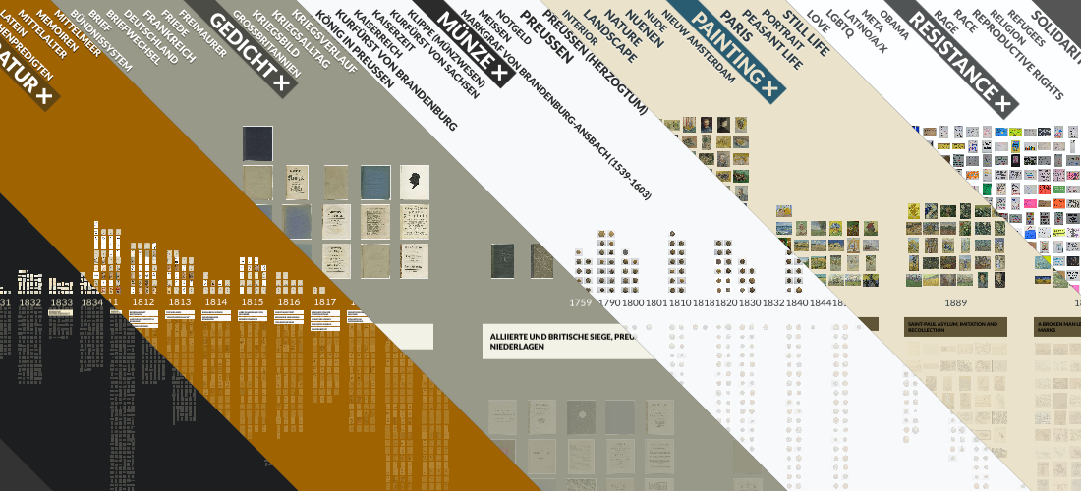
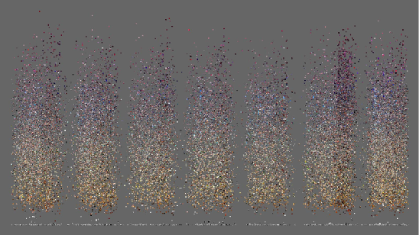
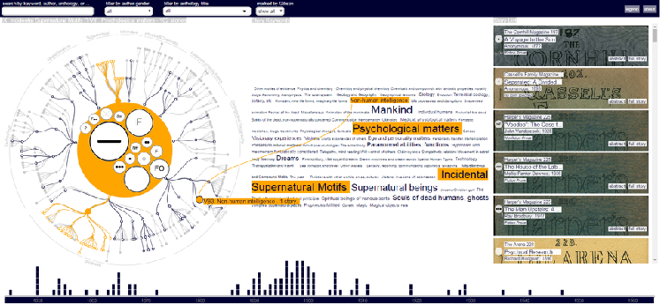
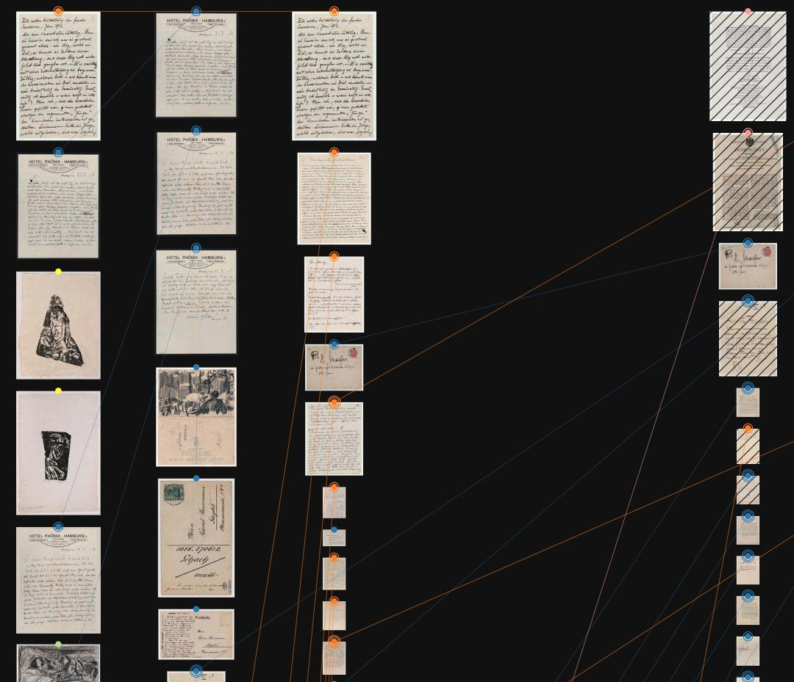
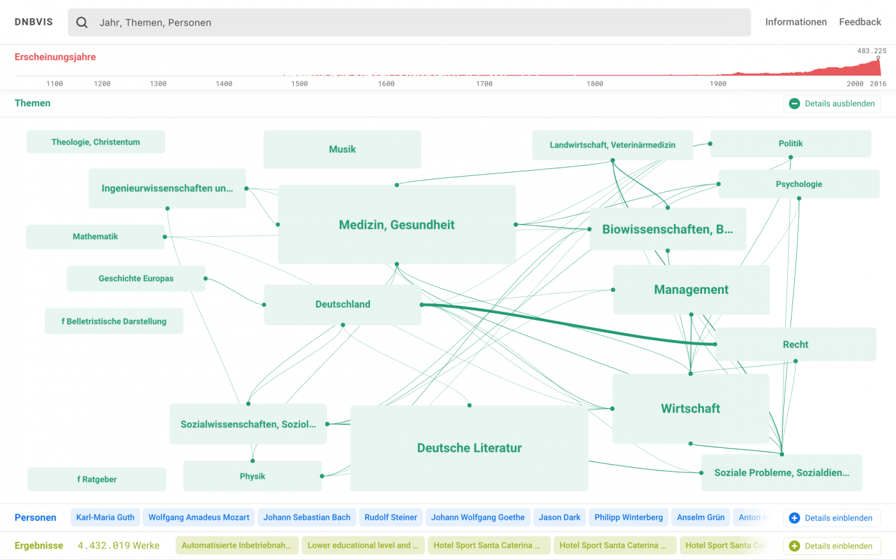
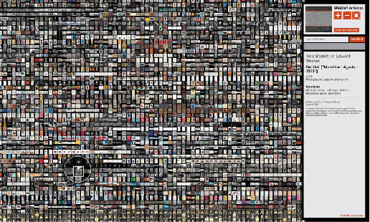
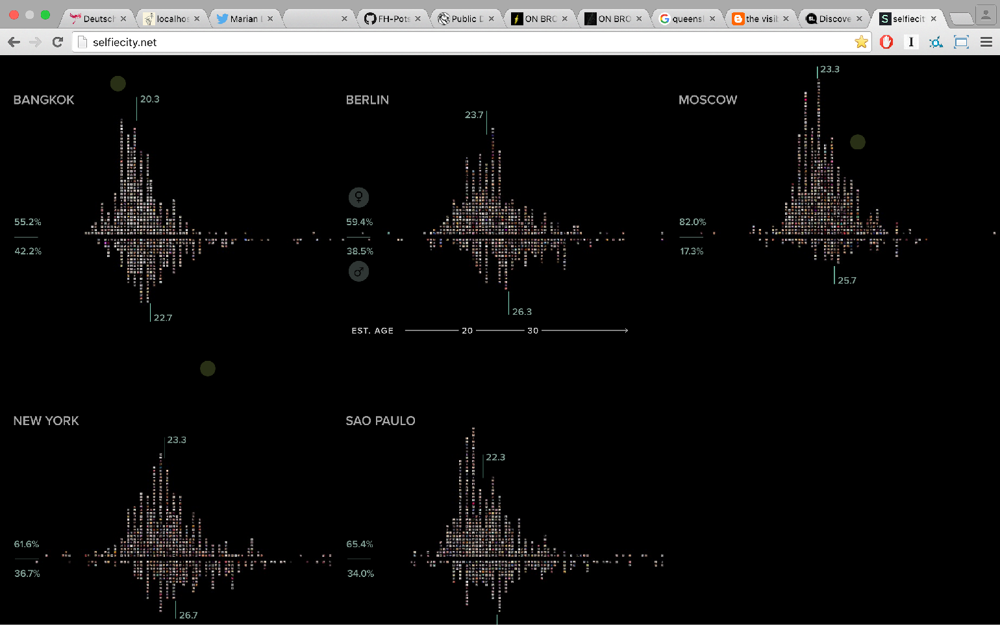
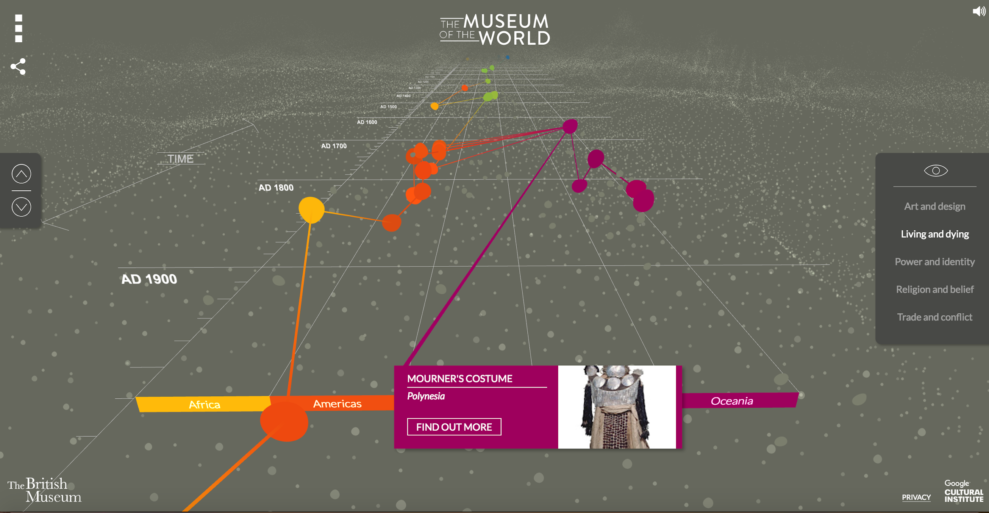
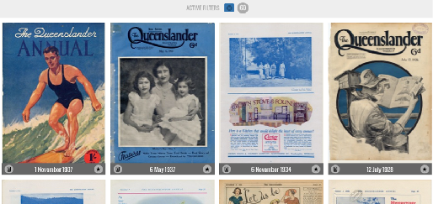
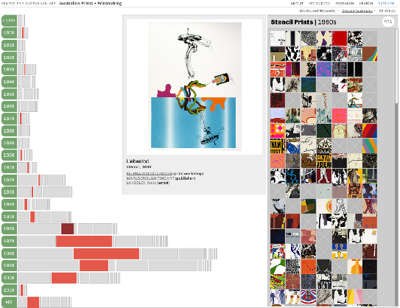
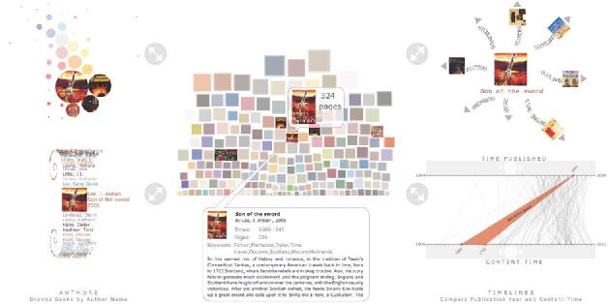
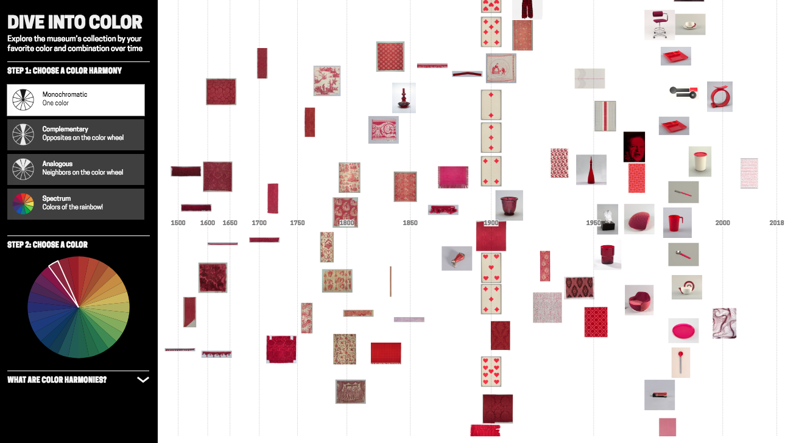
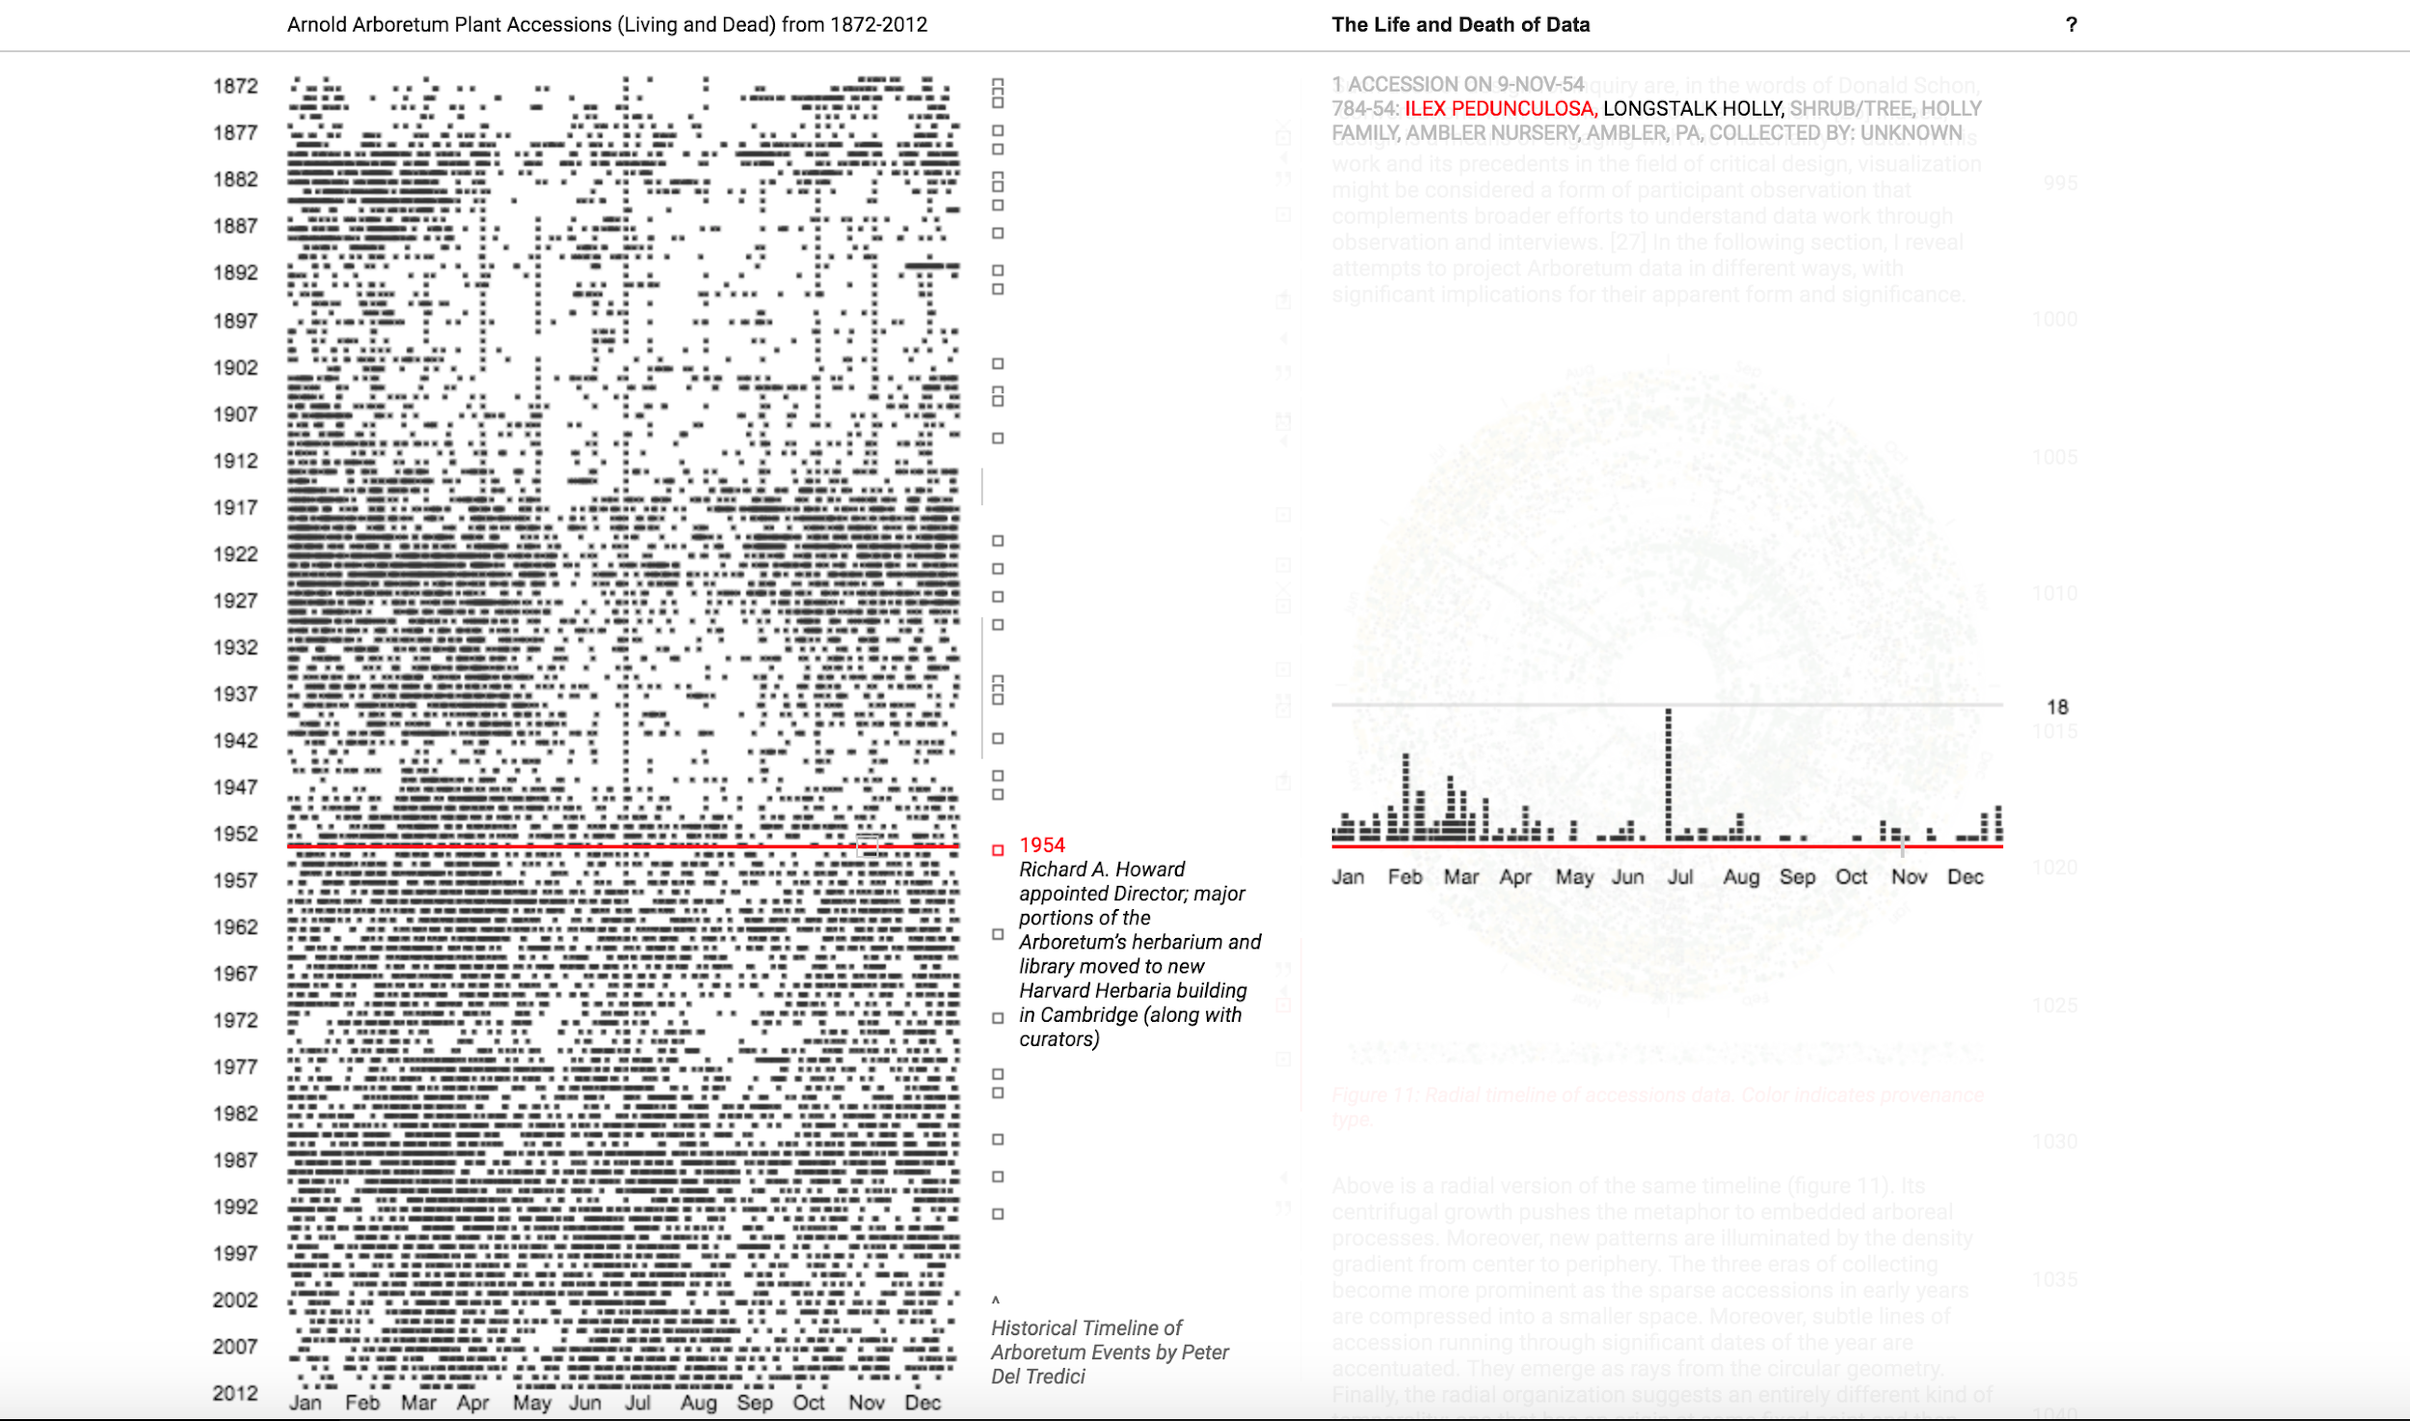
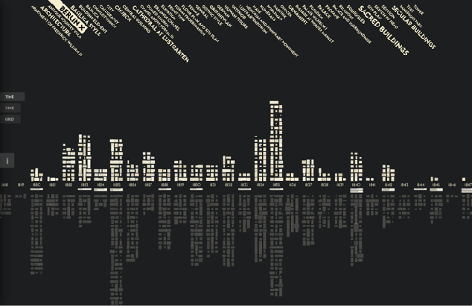
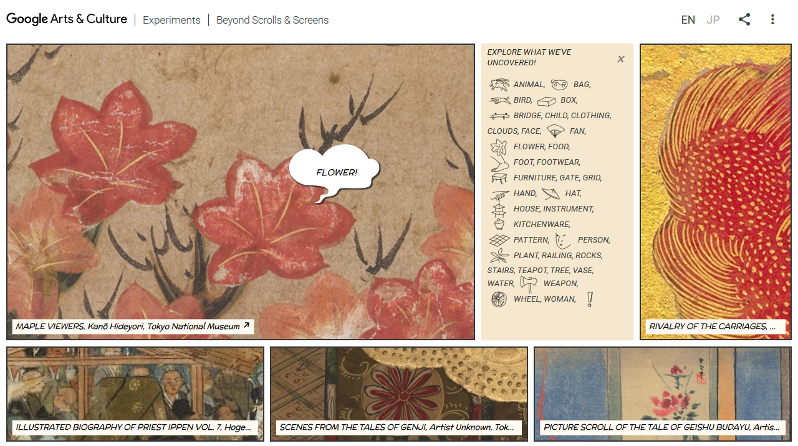
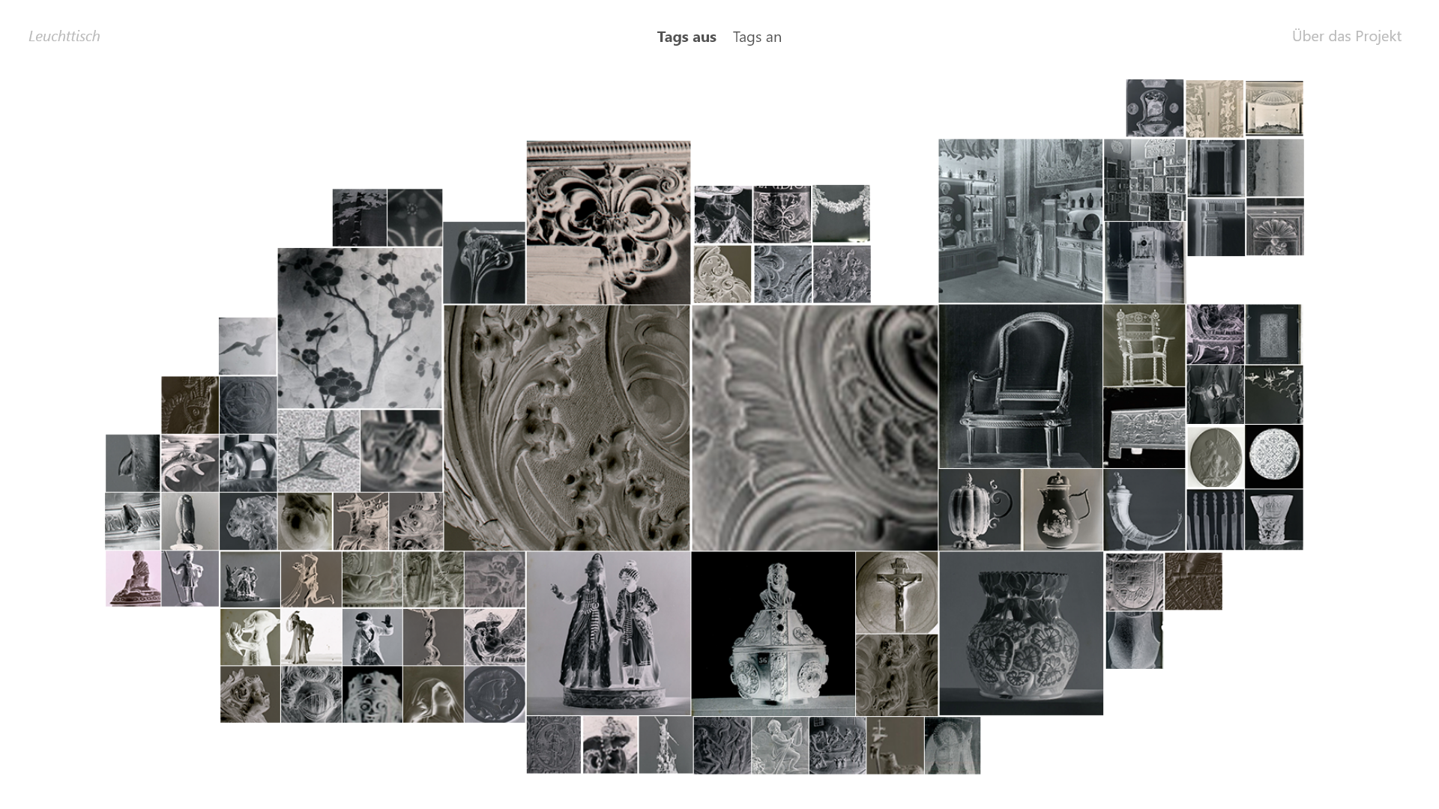
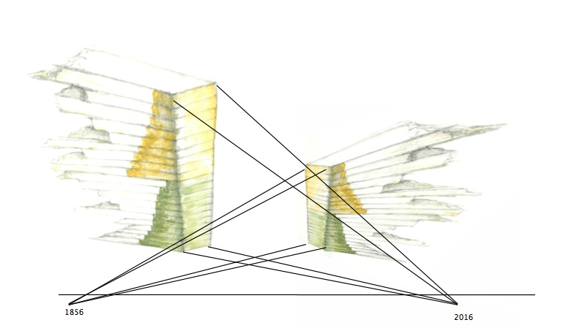
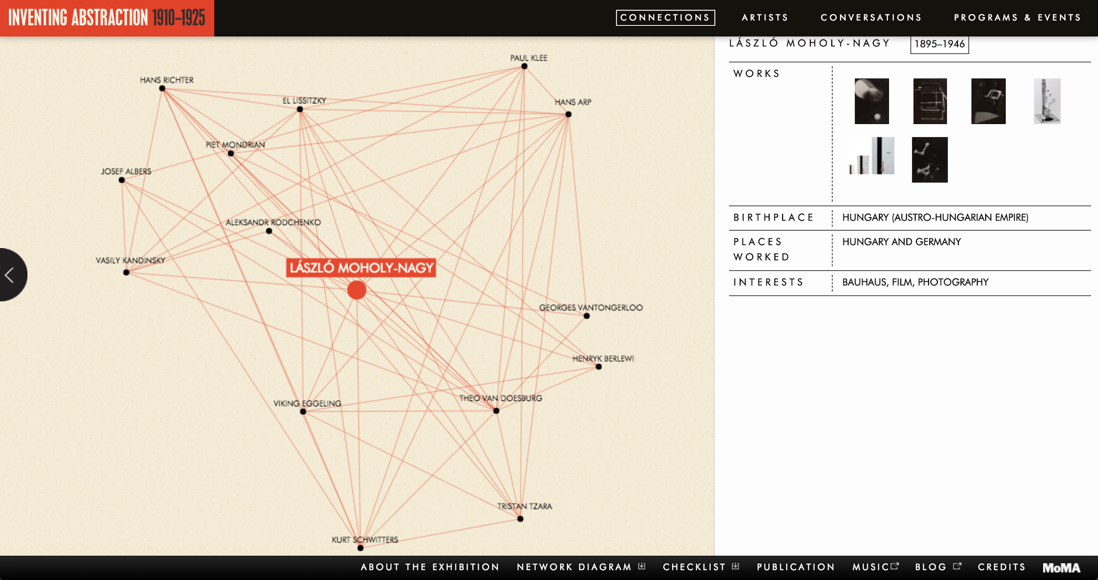
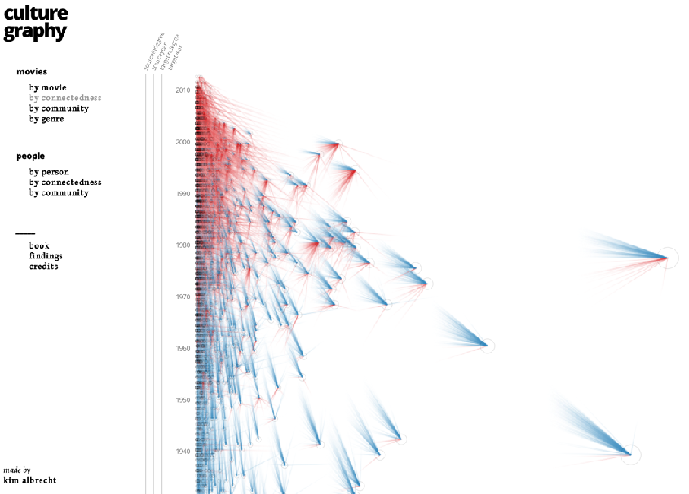
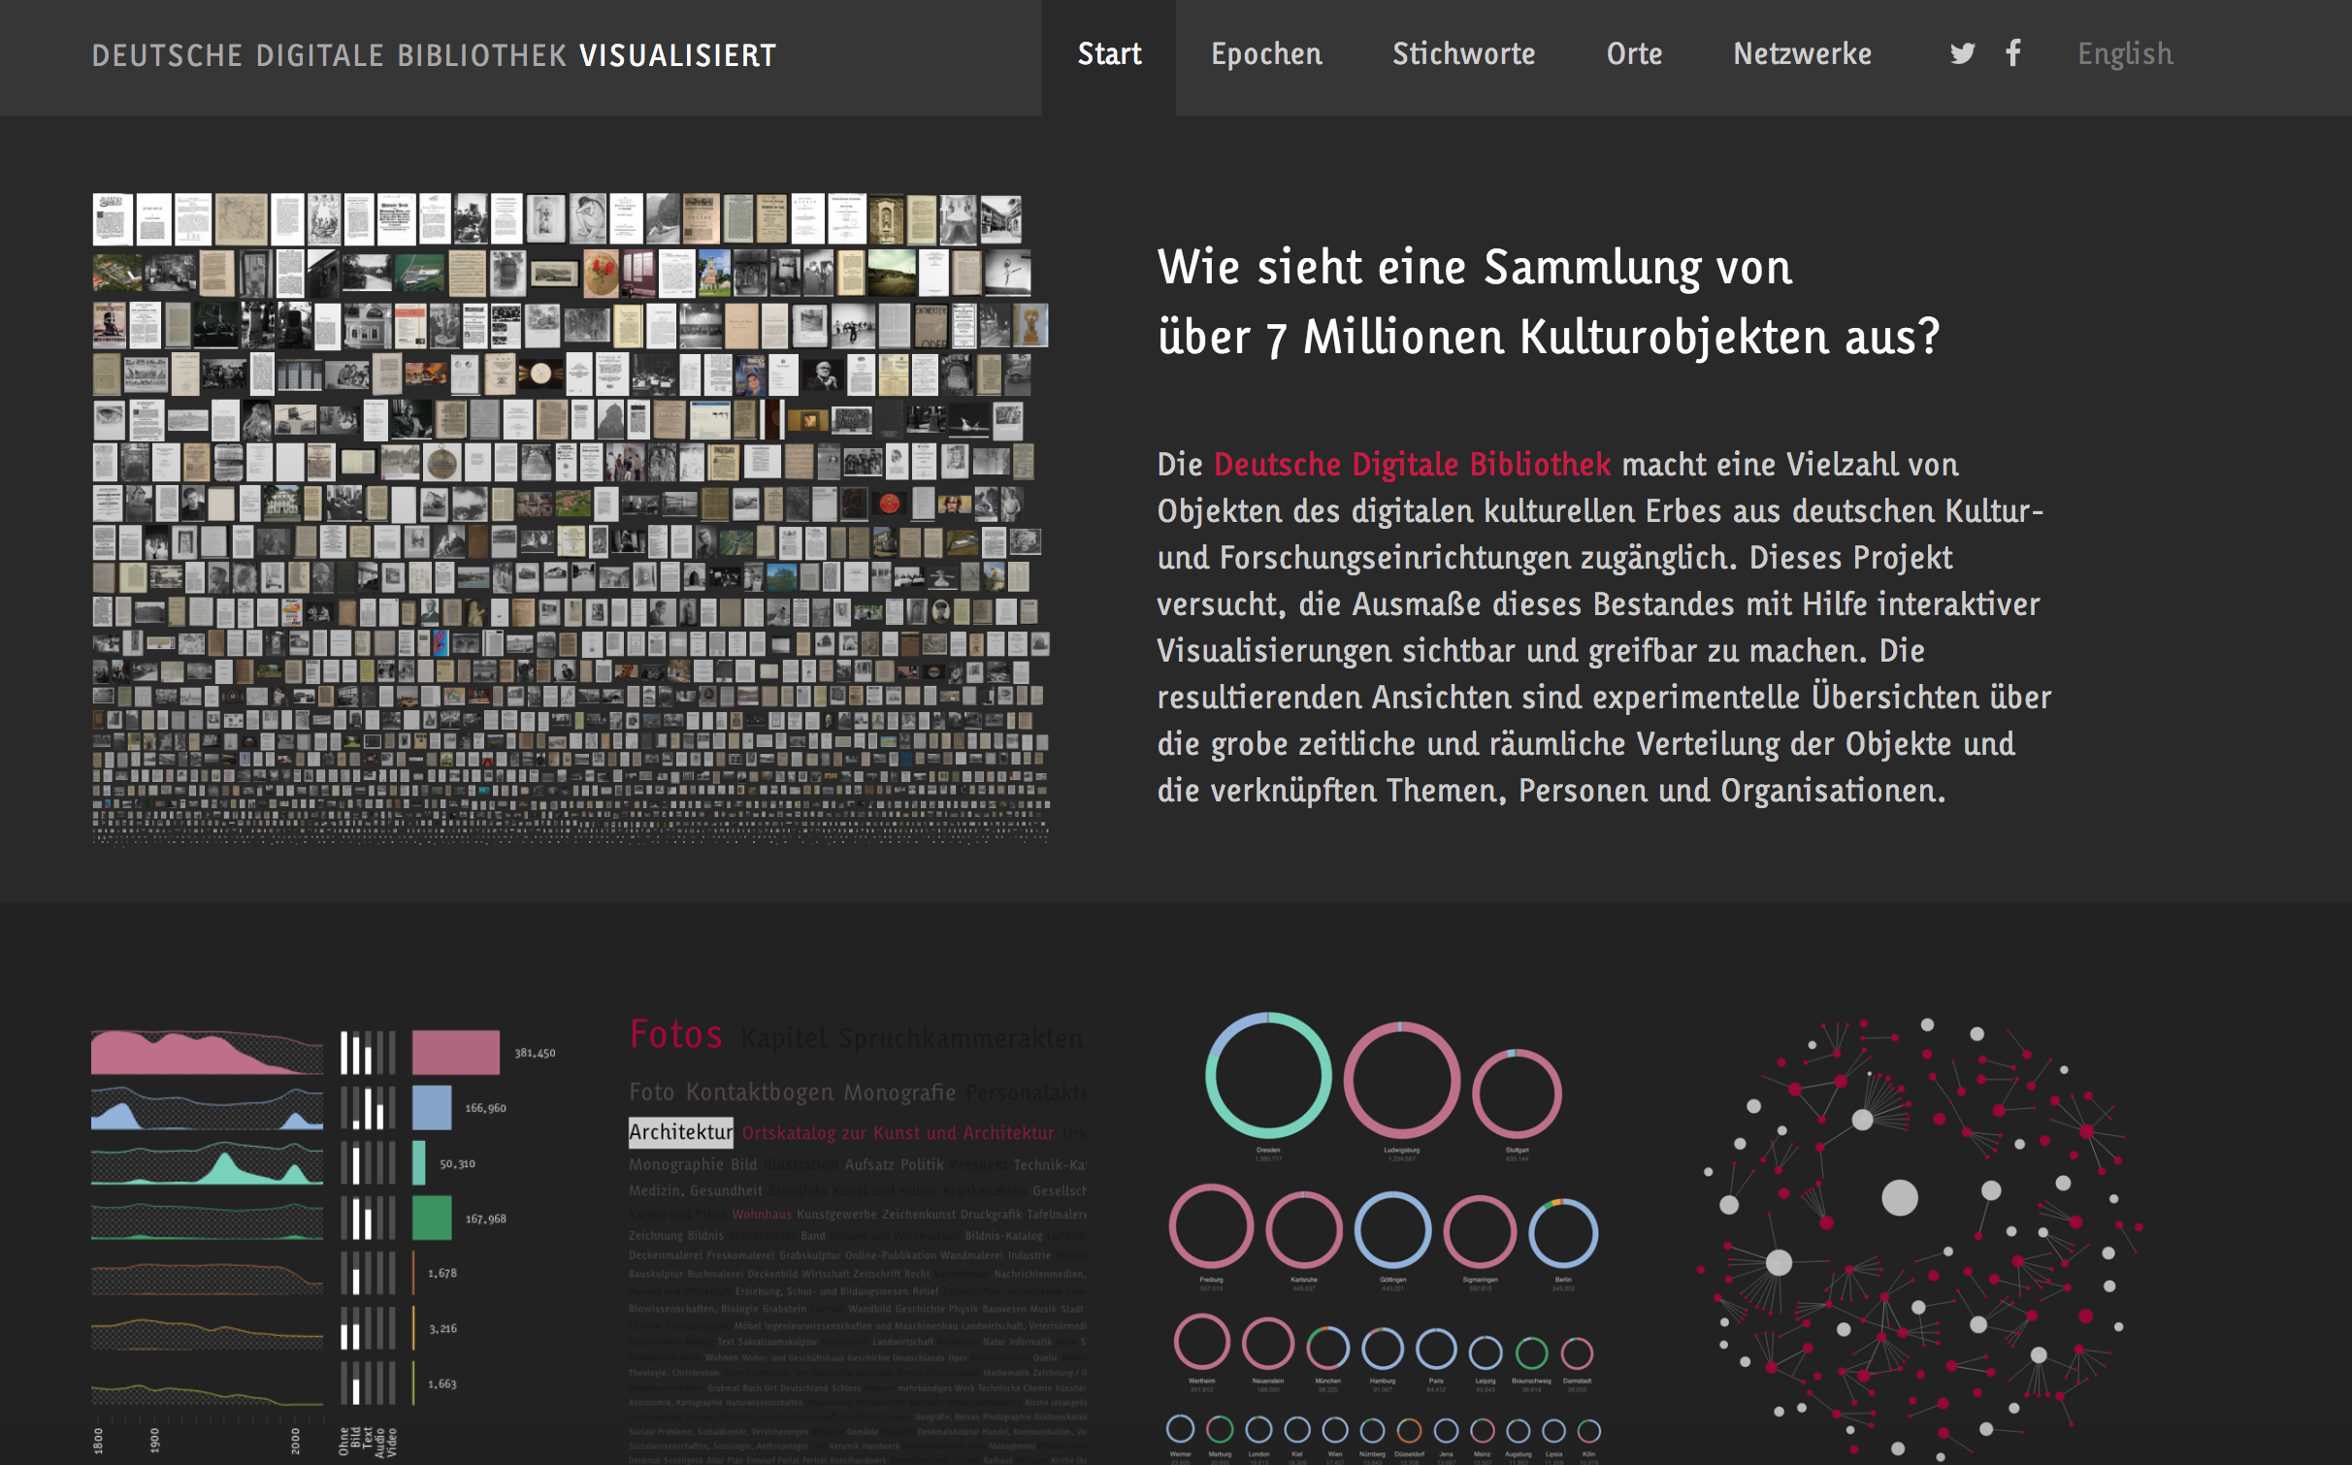
Definition Information Visualization
Discover patterns and relations
Based on human
perception
»The use of computer-supported, interactive, visual representations of abstract data to amplify cognition.«
no spatial relation
Make relations, interpretations and decisions
Card et al. (1999), 7.
Notes:
The basis of every visualization are data, so for cultural collections, this means that the objects or artworks are transferred into a structured list or other kind of data in a first step → this is already an interpretation process!
InfoVis then finds a visual representation for the data points or objects in our case: This can be the objects themselves or abstract representations like dots, arrows, colors
It is also about interactive possibilities, making it possible to navigate through the collections in certain ways → exploration is an important concept for our sense of visualization → enabling free movement for a diverse set of participants
Visualizations also want to “amplify cognition” → offer interpretations, make people look differently at something → but we have to be careful about who talks to who in these scenarios and which opinions are left out eventually

Slide 5
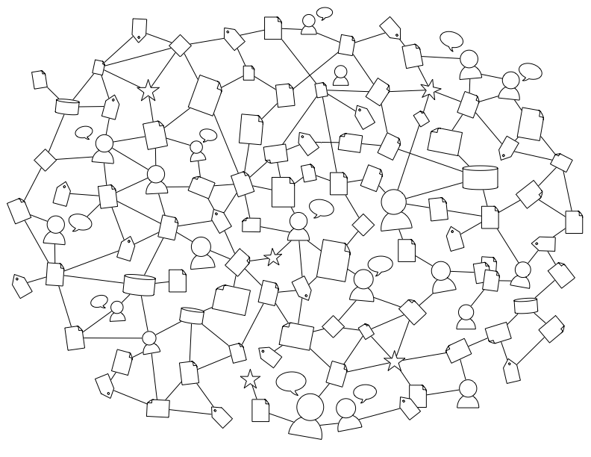
Iconicity
Icon signs
Representation
Sign Processes
Symbolic Embedment
Relations
Semantic Contextualization
Visual externalization

Slide 6
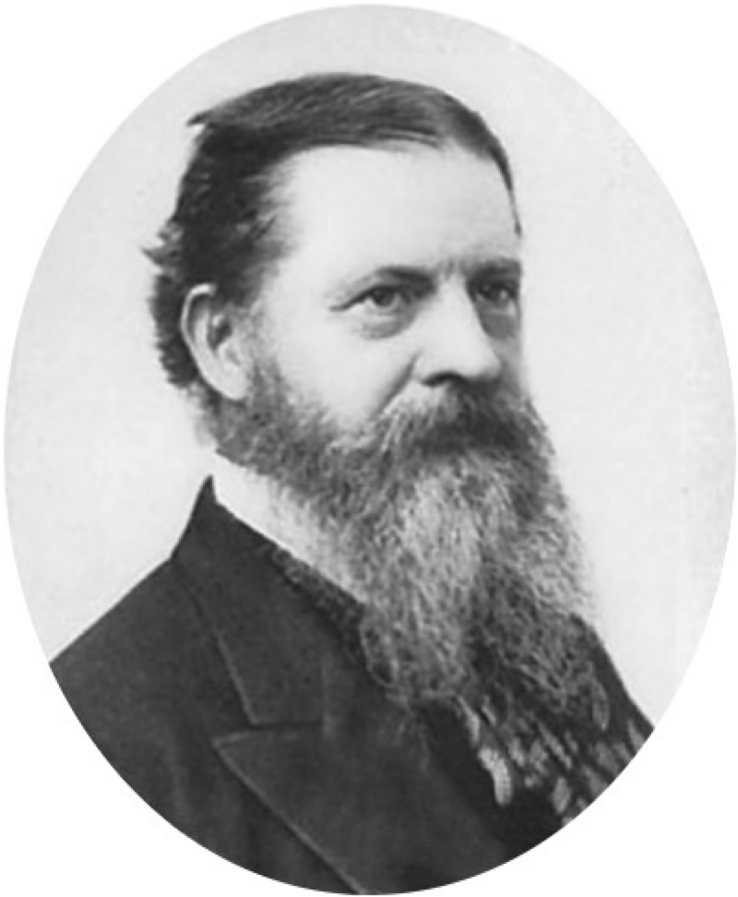
Diagrammatic reasoning
All necessary reasoning without exception is diagrammatic.
CP 5.162
For a great distinguishing property of the icon is that by the direct observation of it other truths concerning its object can be discovered than those which suffice to determine its construction
CP 2.279

Slide 7
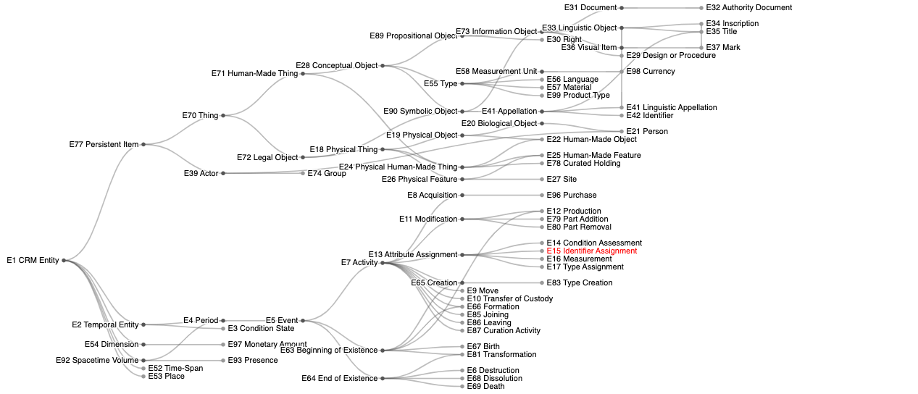
Data Modelling

Slide 8
Semantic Contextualization
Data (given/objective)
vs.
Capta (taken and constructed)
See Drucker (2011): Humanities Approaches to Graphical Display.

Slide 9
Thank you!
Contact:
linda.freyberg@fh-potsdam.de
Website:
https://uclab.fh-potsdam.de/people/linda-freyberg/

